Slide 1

(A)
(B)
Rhythmic
LD
SD
Non rhythmic
Max Expression (FPKM)
929
5272
832

Slide 2
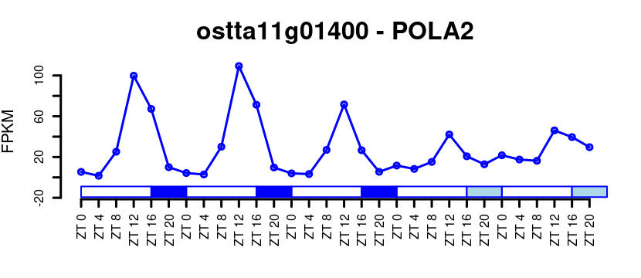
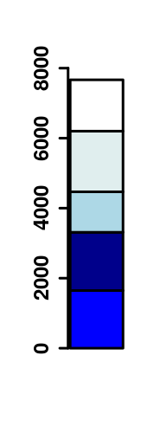
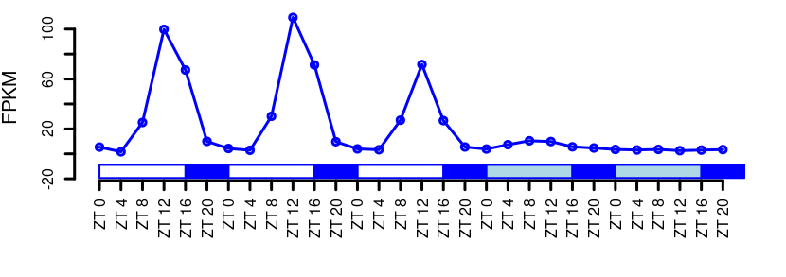
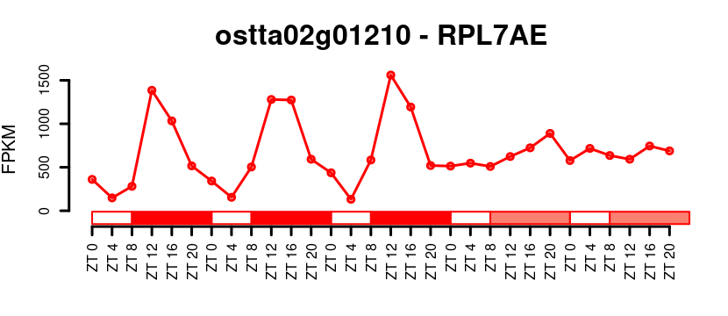
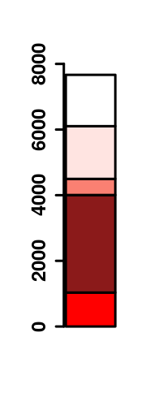
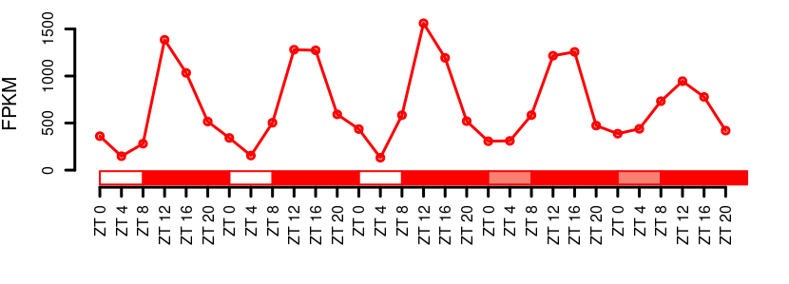
(A)
(B)
Non Rhythmic LD
Rhythmic only LD
Rhythmic LD/LL
Rhythmic LD/DD
Rhythmic LD/LL/DD
(C)
(D)
Non Rhythmic SD
Rhythmic only SD
Rhythmic SD/LL
Rhythmic SD/DD
Rhythmic SD/LL/DD

Slide 3
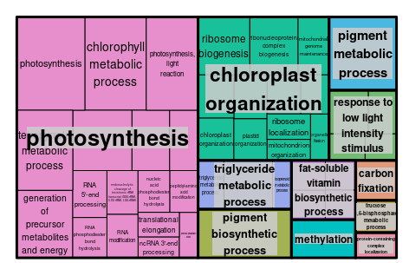
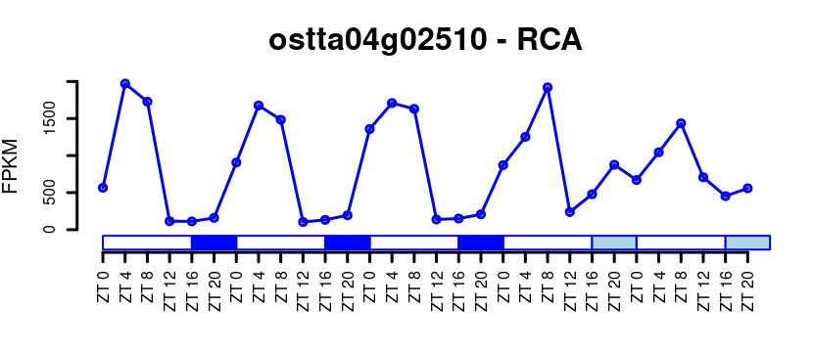
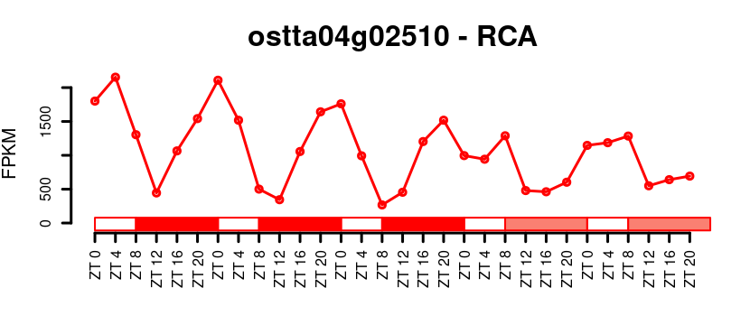
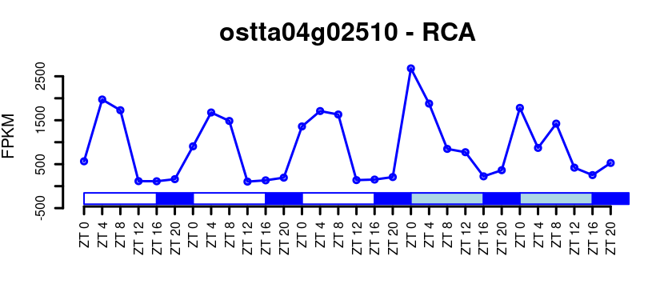
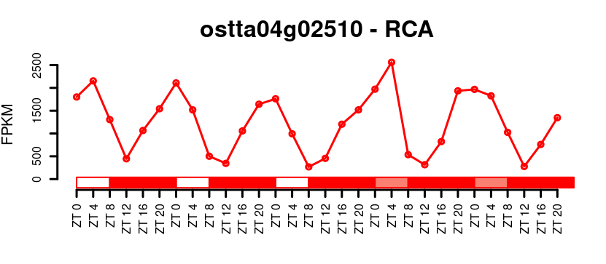
(A)
(C)
LD
SD
1297
350
684
(B)

